Slide 1
The Ancient Egyptians Calendar
By Isla Law 6P

Slide 2
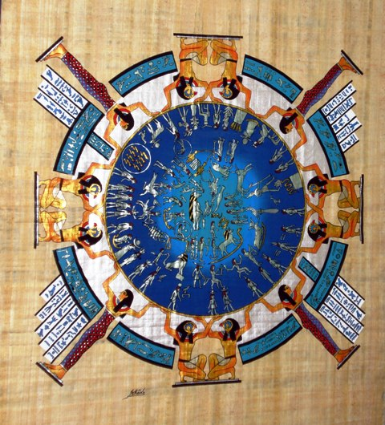
The Ancient Egyptians Calendar was slightly different to ours nowadays it was made up of 12 months each 30 days long with 5 days of festivities at the end!

Slide 3
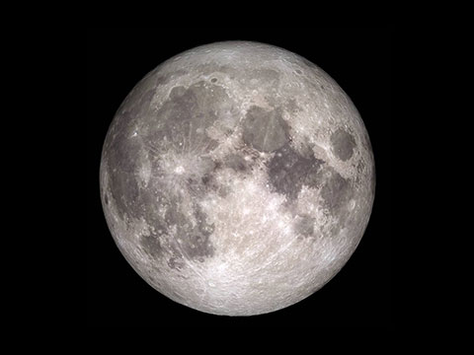
Lunar and Solar Calendars
The Ancient Egyptians firstly used a lunar calendar before they decided their calendar should be a solar one
A lunar calendar is a calendar that measures the phases of the moon to measure time whereas the solar calendar usually measures the time between vernal equinoxes ( when the sun crosses the celestial equator )

Slide 4
TH END!
The Ancient Egyptians also had a 365 day year just like us nowadays so in conclusion we still have similarities such as we still have leap years etc.

